Slide 1
Varying hole distance
problem description
Notes:
C:\Manasses

Slide 2
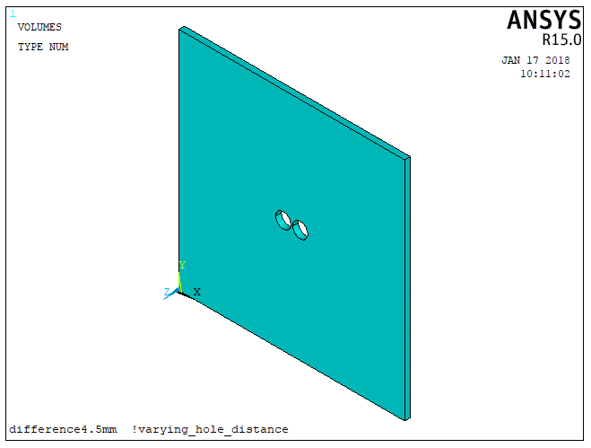
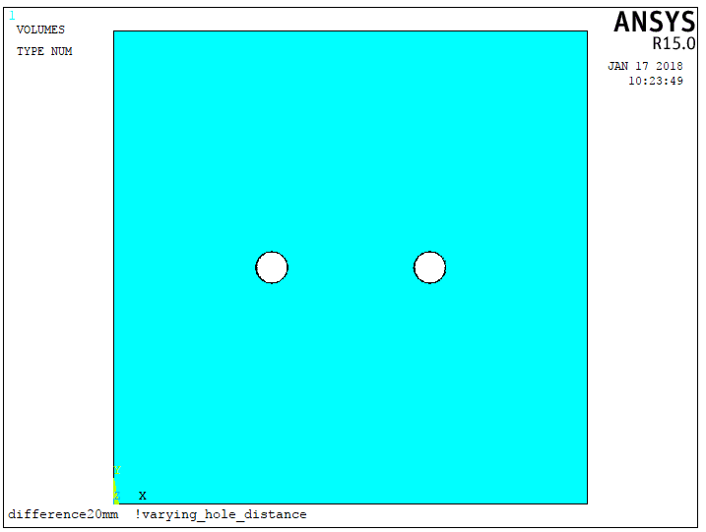
Two Circular Holes in a Plate
60 mm
radius = 2 mm
60 mm
diff
plate_thickness = depth = 1.5 mm
“through hole”
Varying the hole distance

Slide 3
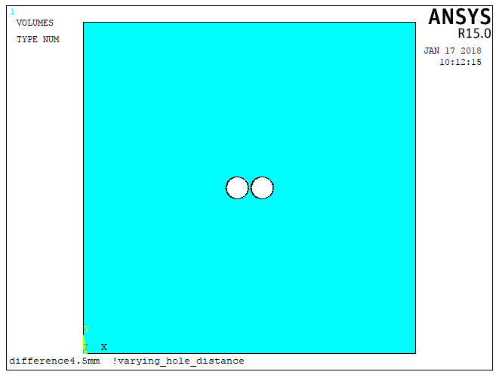
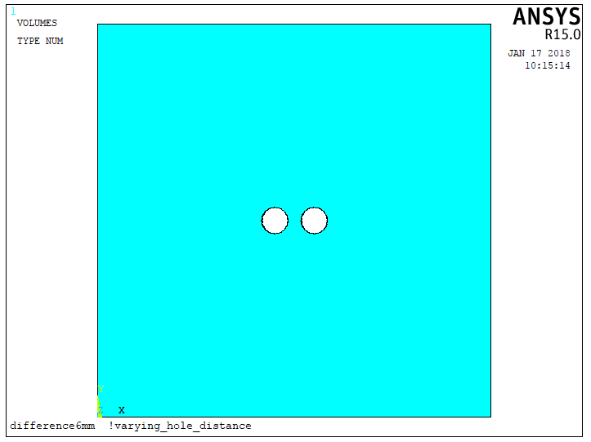
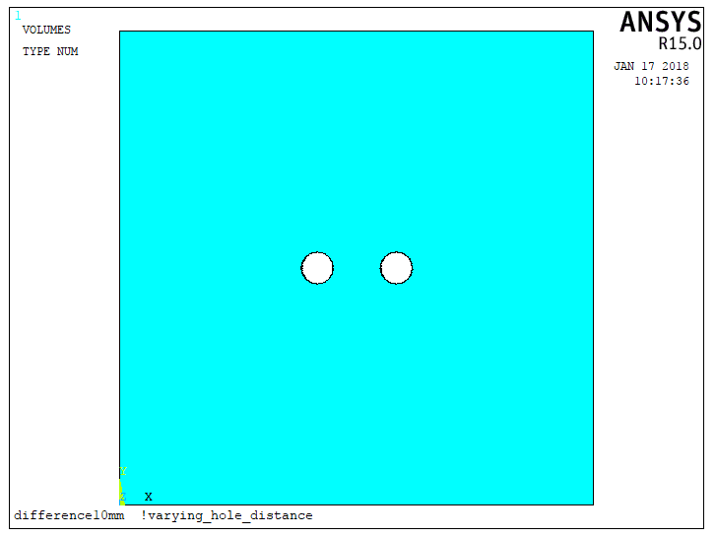
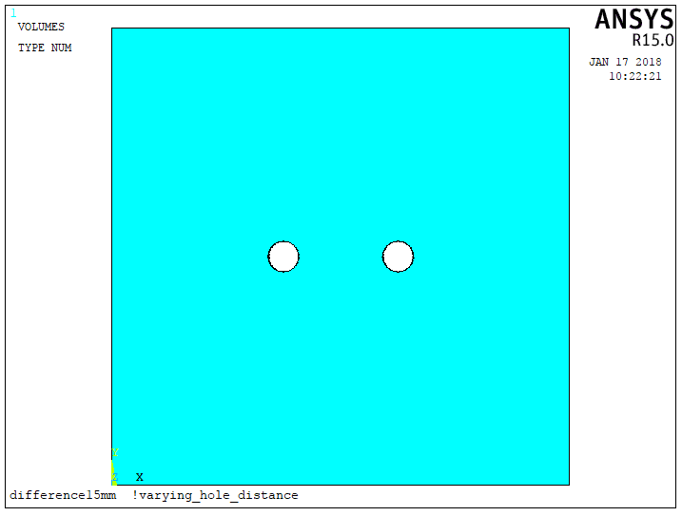
Simulation Goal
inicial = 4.5 !mm
final = 20 !mm
incr = 0.5 !mm
diff
*do,diff,inicial,final,incr
...
...
*enddo

Slide 4
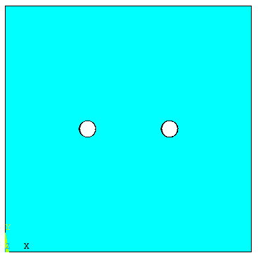
Types of Loads for simulation
(a) Uniaxial
Transverse load
(b) Biaxial load

Slide 5
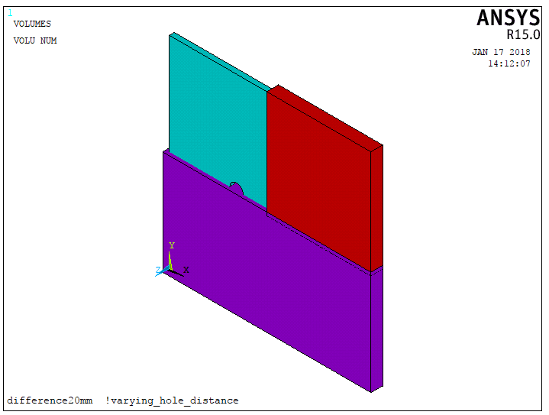
Symmetry

Slide 6
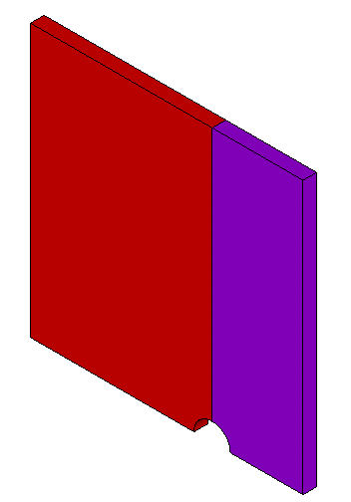
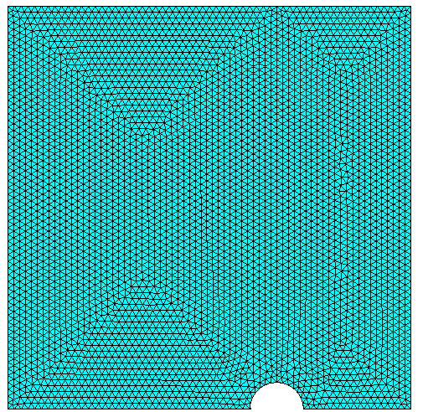
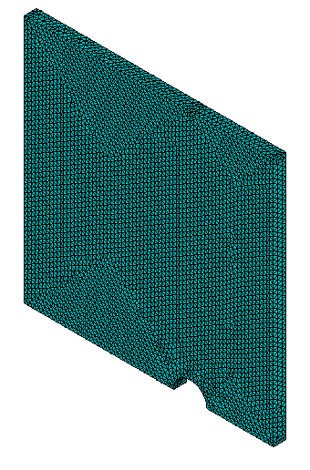
Mesh
! Mesh
! Selection volumes
allsel
! Type element
et,1,187
! Element edge
size= 0.5
esize,size
!command
vmesh,all
eplot
Duo the interest in the data from the nodes in the commom area, A1, two volumes were modeled.
A1

Slide 7
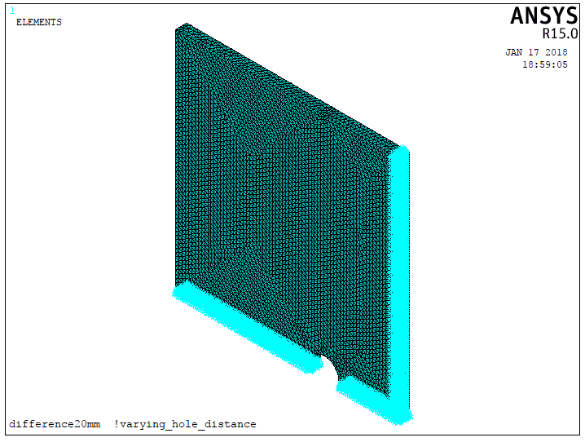
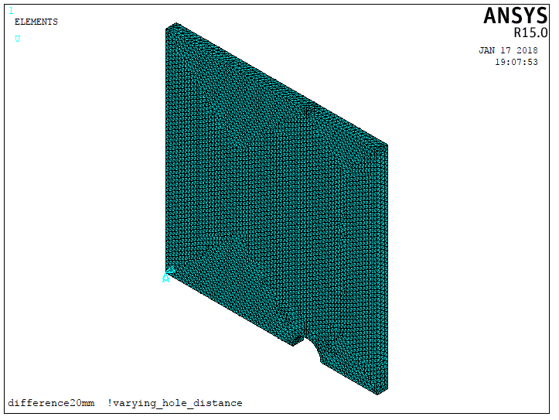
Symmetry and Boundary Conditions
! Symmetry Condition
!(cross section X)
asel,s,loc,x,x2/2
nsla,s,1
dsym,symm,x,0
!(cross section Y)
asel,s,loc,y,y2/2
nsla,s,1
dsym,symm,y,0
! Boundary Condition
allsel
ksel,s,loc,x,x1
ksel,r,loc,y,y2/2
ksel,r,loc,z,z1
nslk,s
d,all,uz,0

Slide 8
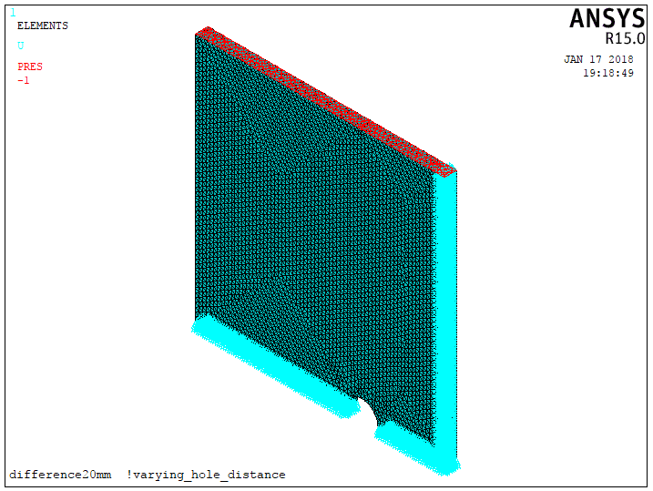
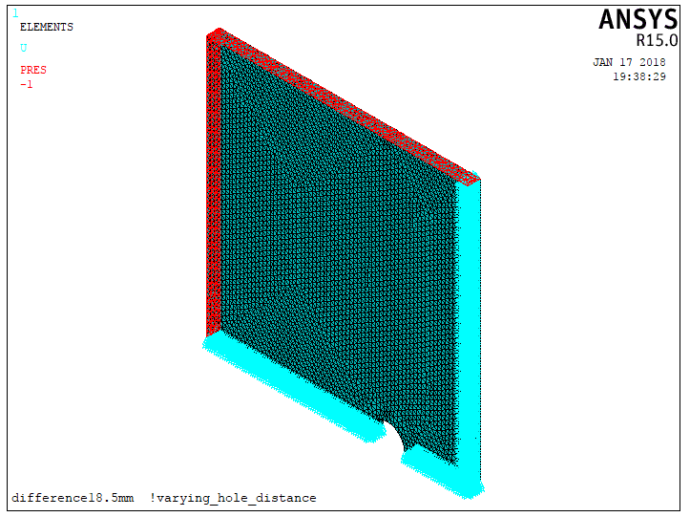
Load Conditions
Uniaxial, Transverse load
! p = 1 Mpa
allsel
asel,s,loc,y,y2
sfa,all,1,pres,-p
asel,s,loc,y,y1
sfa,all,1,pres,-p
allsel
lswrite,1
Biaxial load
allsel
asel,s,loc,x,x2
sfa,all,1,pres,-p
asel,s,loc,x,x1
sfa,all,1,pres,-p
allsel
!lswrite,1
allsel
asel,s,loc,y,y2
sfa,all,1,pres,-p
asel,s,loc,y,y1
sfa,all,1,pres,-p
allsel
lswrite,2

Slide 9
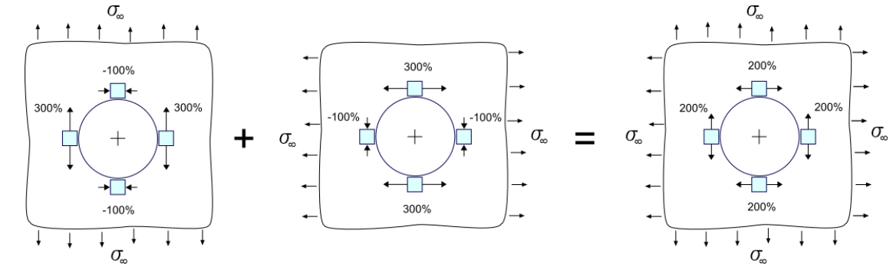
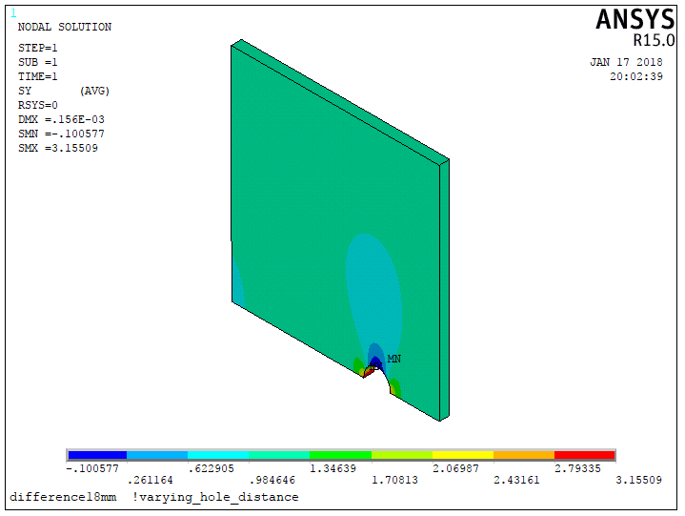
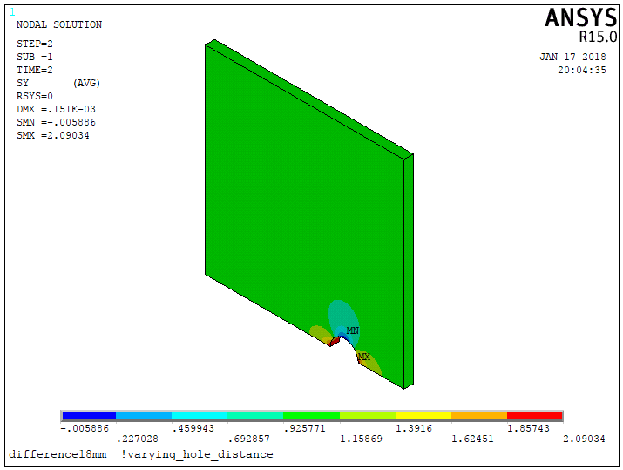
Solution
Theoretical Results
!cont=1 Uniaxial
!cont=2 Biaxial
finish
/solu
lssolve,cont
save
/post1
plnsol,s,y
Uniaxial, Transverse load
Biaxial load

Slide 10
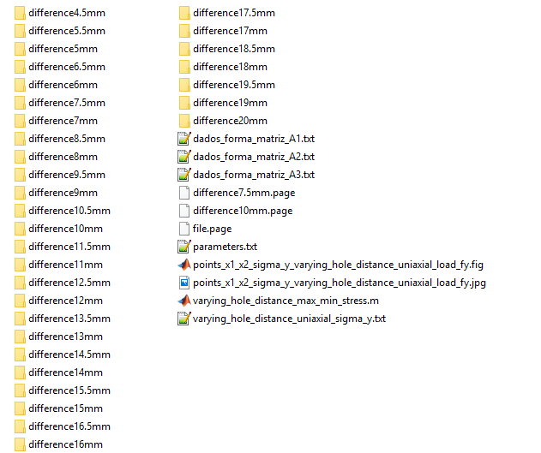
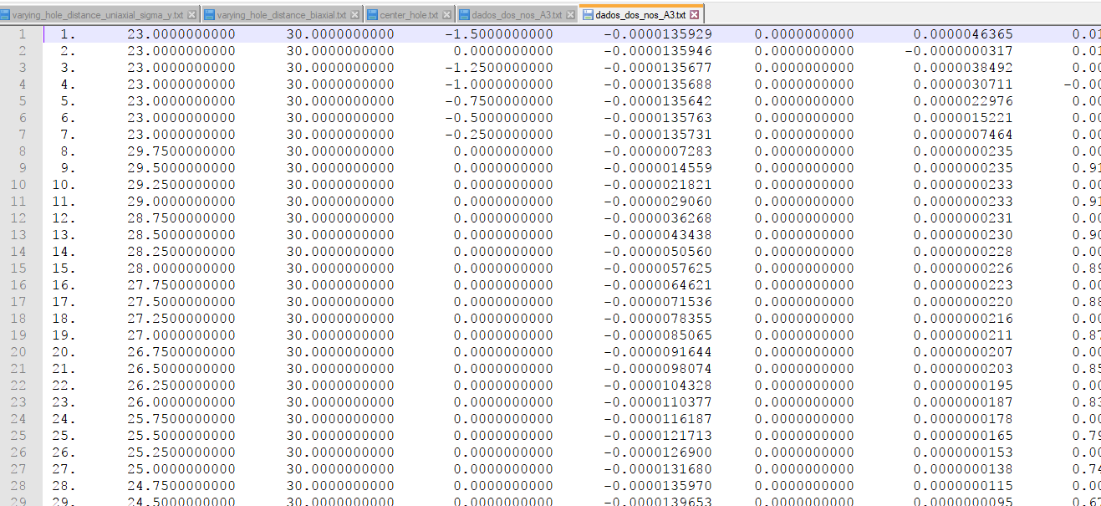
Obtaining Data
/cwd,wd(1,1)
/input,dados_forma_matriz_A3,txt !(cria arquivo dados_dos_nos_A3.txt)
! ARMAZENAMENTO DE DADOS
*vget,dados_dos_nos_A3(1,1),node,menor_numero_de_nos,loc,x
*vget,dados_dos_nos_A3(1,2),node,menor_numero_de_nos,loc,y
*vget,dados_dos_nos_A3(1,3),node,menor_numero_de_nos,loc,z
*vget,dados_dos_nos_A3(1,4),node,menor_numero_de_nos,u,x
*vget,dados_dos_nos_A3(1,5),node,menor_numero_de_nos,u,y
*vget,dados_dos_nos_A3(1,6),node,menor_numero_de_nos,u,z
*vget,dados_dos_nos_A3(1,7),node,menor_numero_de_nos,s,x
*vget,dados_dos_nos_A3(1,8),node,menor_numero_de_nos,s,y
*vget,dados_dos_nos_A3(1,9),node,menor_numero_de_nos,s,z
*vget,dados_dos_nos_A3(1,10),node,menor_numero_de_nos,s,eqv
/input,dados_forma_matriz_A3,txt
Notes:
C:\Manasses\varying_hole_distance

Slide 11
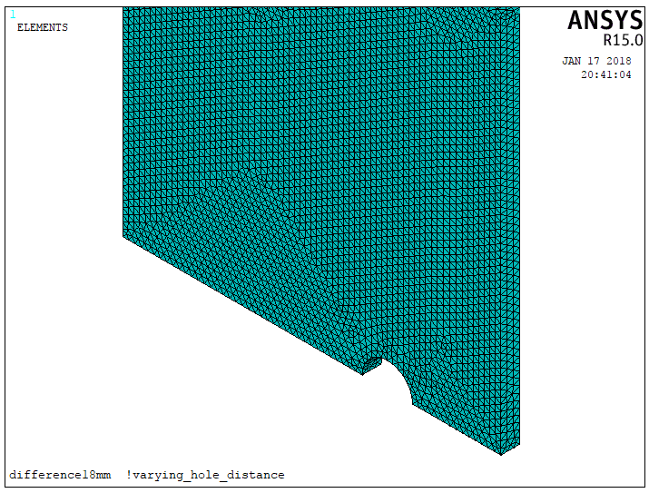
Manipulating Data – Matlab Code
diff=[6:0.5:20]; %Point differences to be read
[m n] = size(diff);
r = 2; %hole radius
L = 60;
for a=1:1:n %going through each point difference
path=['C:\Manasses\varying_hole_distance\',axial{cont},'\difference',num2str(diff(a)),'mm\'];
nome='dados_dos_nos_A3.txt';%file name
[n,xloc,yloc,zloc,ux,uy,uz,sx,sy,sz,se]=textread([path nome],'%f %f %f %f %f %f %f %f %f %f %f'); matriz=[n(:,1),xloc(:,1),yloc(:,1),zloc(:,1),ux(:,1),uy(:,1),uz(:,1),sx(:,1),sy(:,1),sz(:,1),se(:,1)];
matriz=sortrows(matriz,2); %Deixa os dados em ordem crescente
[i,j]=find(matriz(:,4)~=0.0);%transversal line at the surface of the plate
matriz(i,:)=[];%exclui os pontos que não estão na superfície do modelo
[i,j]=find(matriz(:,9)==0); %finds sigmax values equal to zero
matriz(i,:)=[];%exclui os valores de tensão igual a zero (nós intermediários)
[i,j]=size(matriz);
x1 = ((L-diff(a))/2)-r;
x2 = ((L-diff(a))/2)+r;
[i,j]=find(matriz(:,2)==x1|matriz(:,2)==x2);
[g h] = size(matriz);
.
.
.
line of interest
Notes:
C:\Manasses\varying_hole_distance

Slide 12
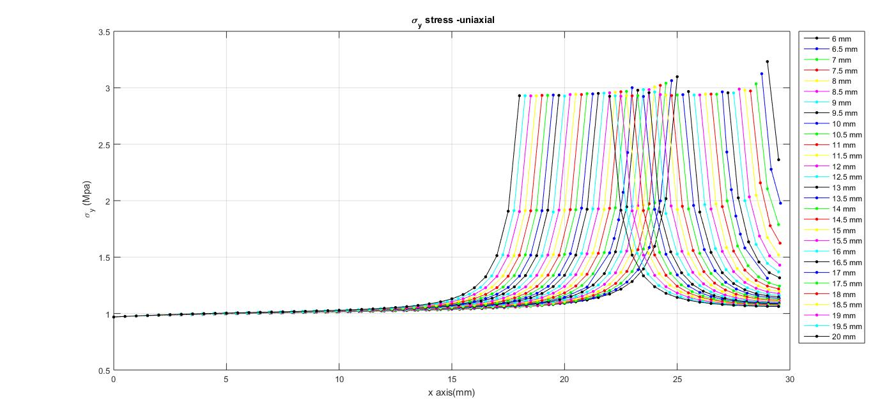
Matlab Plots – stress profile
Varying the hole distance

Slide 13
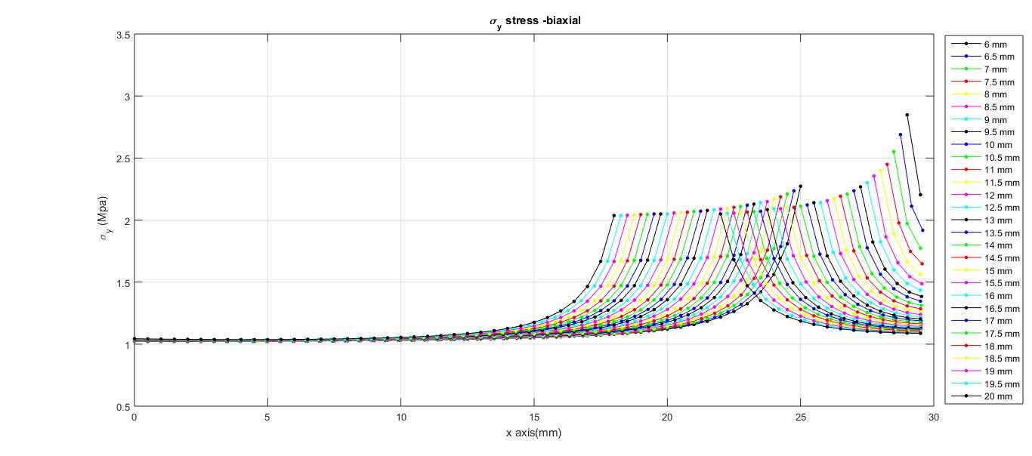
Matlab Plots – stress profile
Varying the hole distance

Slide 14
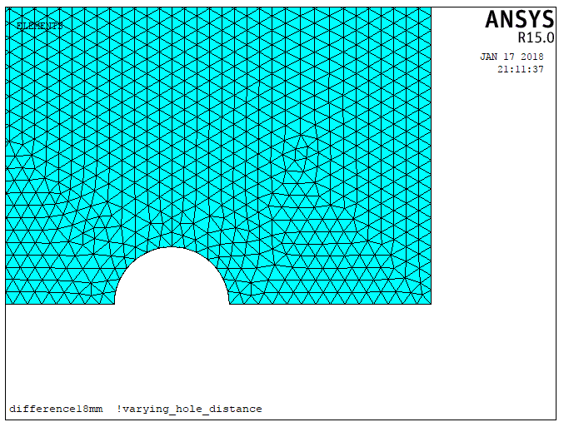
Manipulating Data – Matlab Code
X1
X2

Slide 15
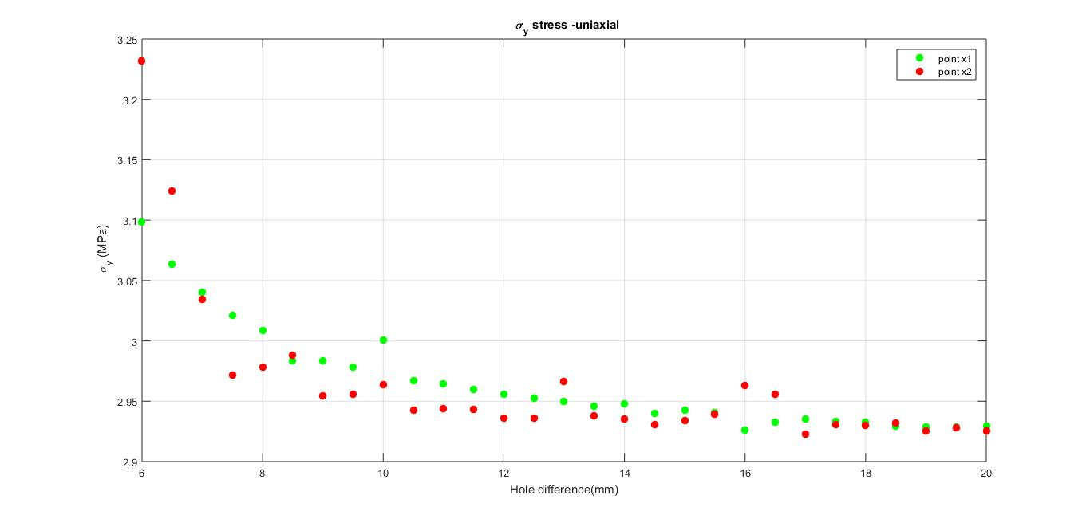
Matlab Plots – stress at points X1, X2
Notes:
C:\Manasses\varying_hole_distance

Slide 16
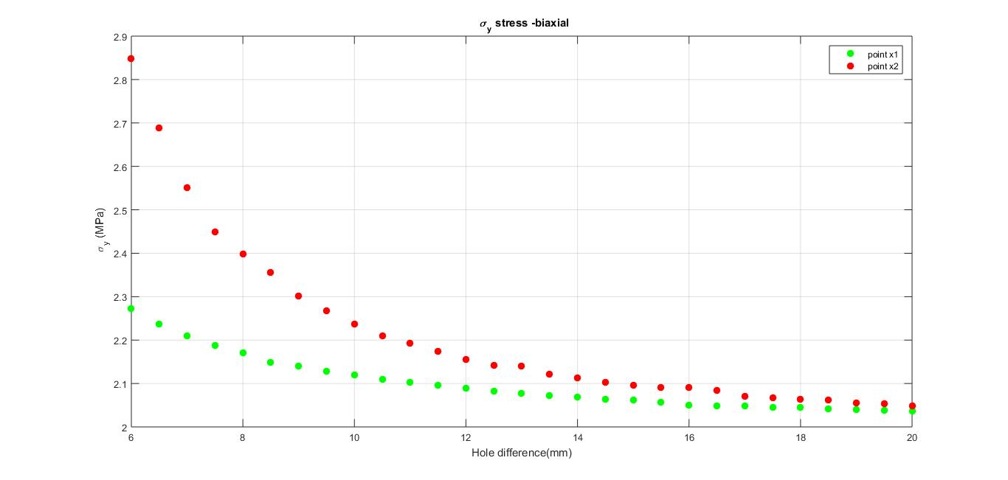
Matlab Plots – stress at points X1, X2
Notes:
C:\Manasses\varying_hole_distance

Slide 17
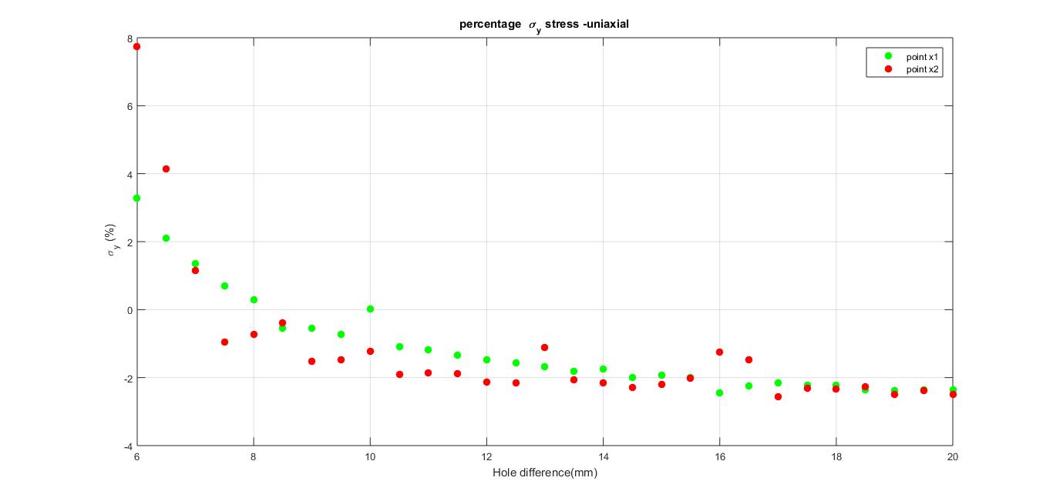
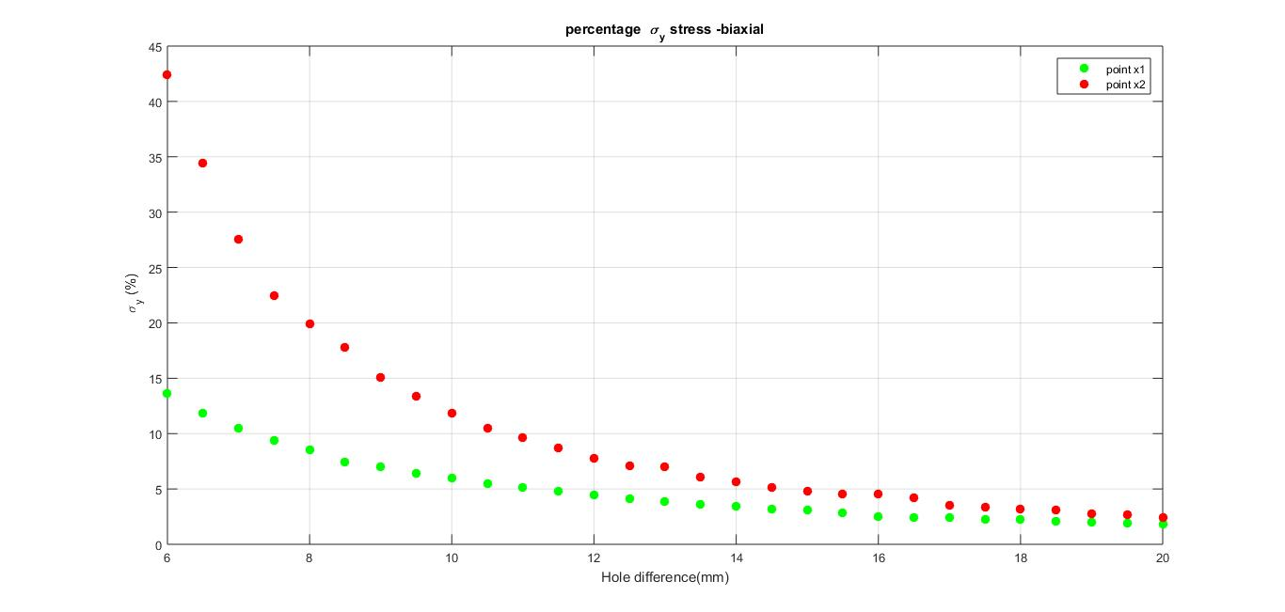
Matlab Plots – percentage, X1, X2
percentage = 100*(Sigmay(x1,x2) – sigmay_theoretical)/(sigmay_theoretical)
Uniaxial, Transverse load
(b)Biaxial load
sigmay_theoretical = 3
sigmay_theoretical = 2
Notes:
C:\Manasses\varying_hole_distance

Slide 18
Matlab Plots – points X1, X2

Slide 19
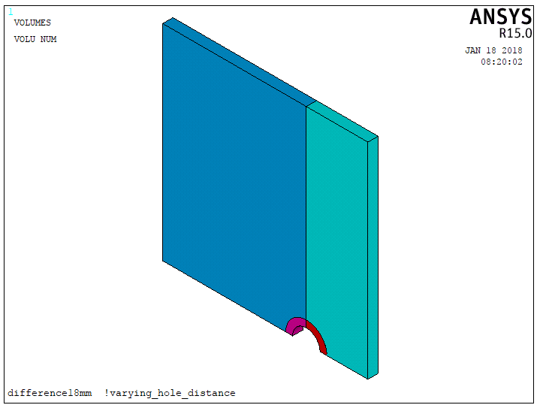
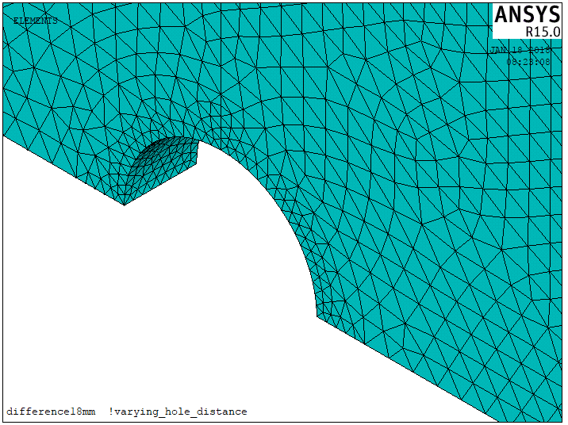
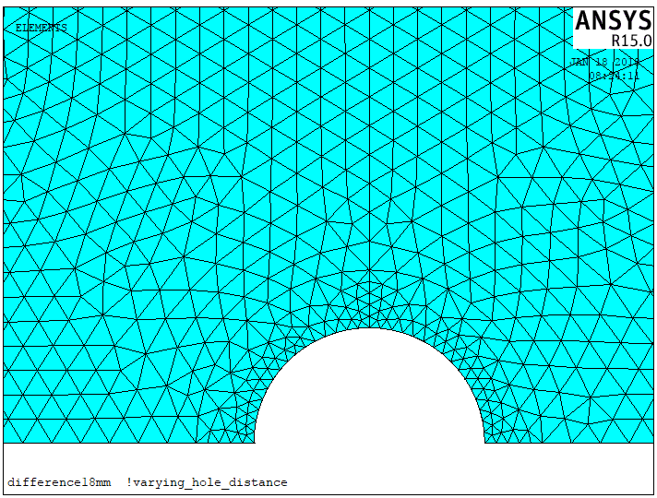
Refined Mesh Region
radius_int1=2.0
radius_ext1=3.0
cyl4,xcenter1,ycenter1,radius_int1,angle_int1,radius_ext1,angle_ext1,-depth1
Notes:
C:\Manasses\varying_hole_distance_with_refined_mesh_region

Slide 20
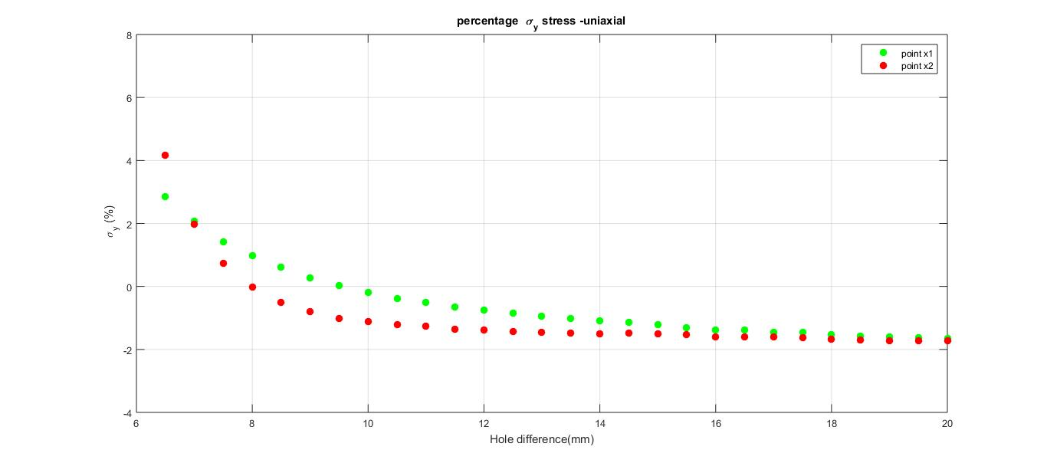
Uniaxial, Transverse load
No Refined Mesh Region
Refined Mesh Region
!mesh
esize,0.5
!coarse mesh
esize,0.5
!fine mesh
esize,0.2
Notes:
C:\Manasses\varying_hole_distance_with_refined_mesh_region

Slide 21
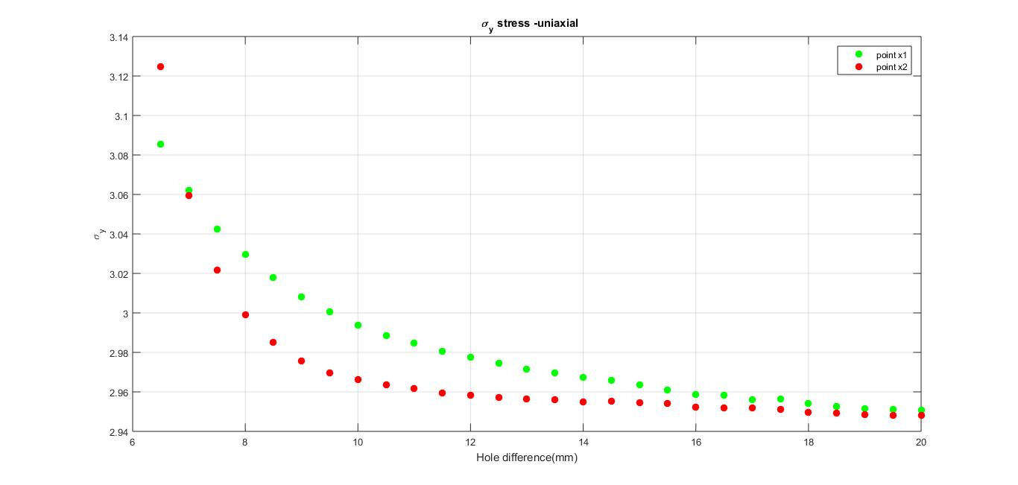
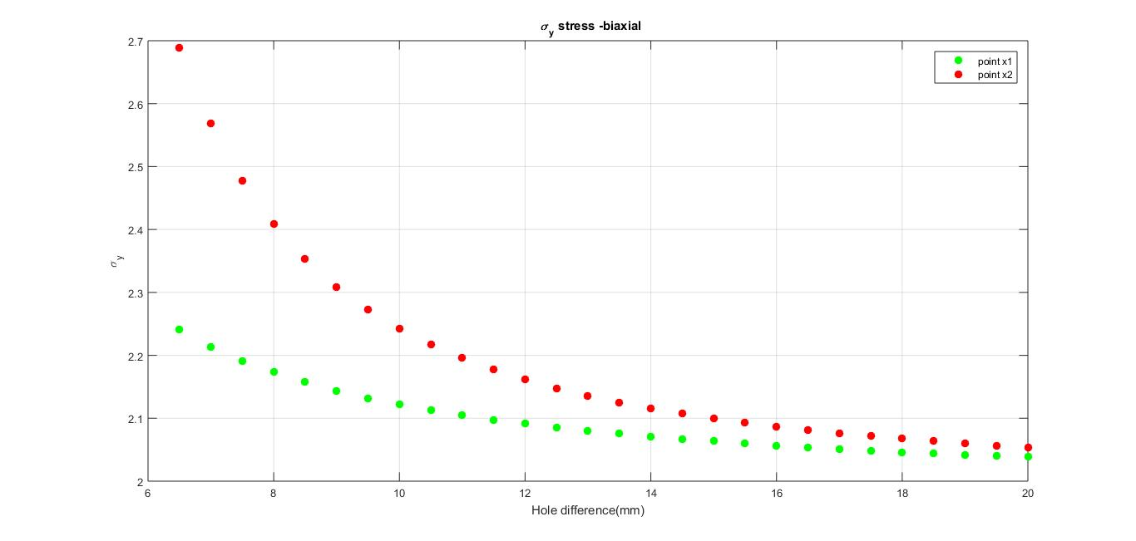
Load Comparison, X1, X2
!coarse mesh
esize,0.5
!fine mesh
esize,0.2
Uniaxial, Transverse load
(b)Biaxial load
sigmay_theoretical = 3
sigmay_theoretical = 2
Notes:
C:\Manasses\varying_hole_distance_with_refined_mesh_region

Slide 22
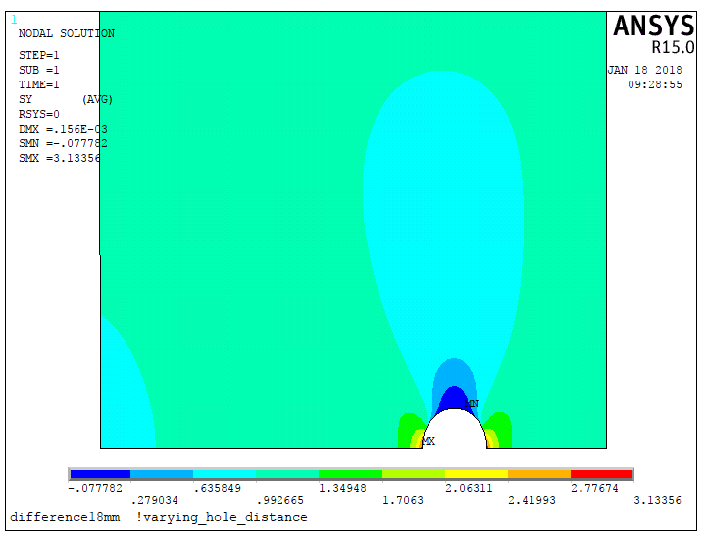
Why X1 > X2 for diff > 7.0 mm?
X1
X2
inicial = 6.5 !mm, minimum, duo the refined mesh region (cylinder)
final = 20 !mm
incr = 0.5 !mm
*do,diff,inicial,final,incr
...
*enddo
Notes:
C:\Manasses\varying_hole_distance_with_refined_mesh_region

Slide 23
Why X1 > X2 for diff > 7.0 mm?
X1
X2
inicial = 6.5 !mm, minimum, duo the refined mesh region (cylinder)
final = 20 !mm
incr = 0.5 !mm
*do,diff,inicial,final,incr
...
*enddo
Notes:
C:\Manasses\varying_hole_distance_with_refined_mesh_region

Slide 24
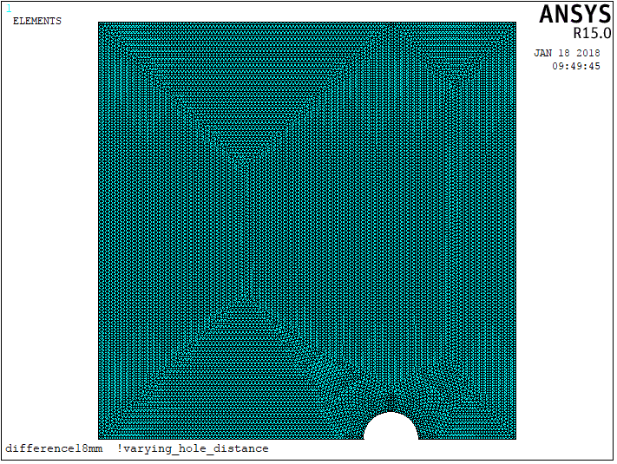
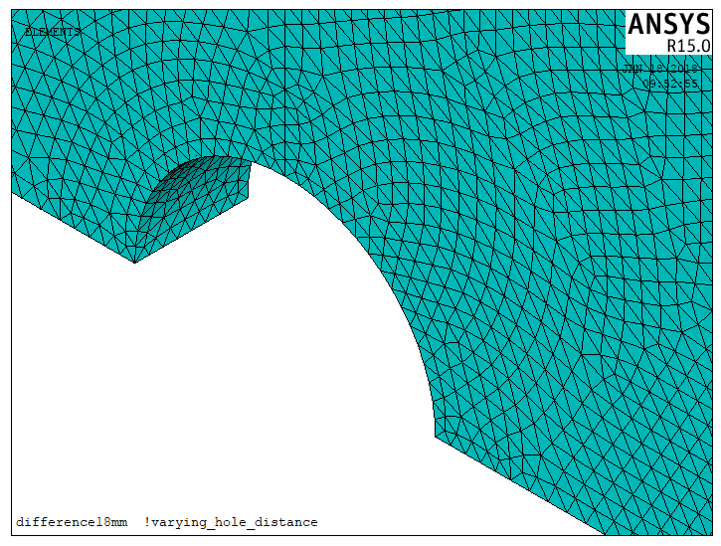
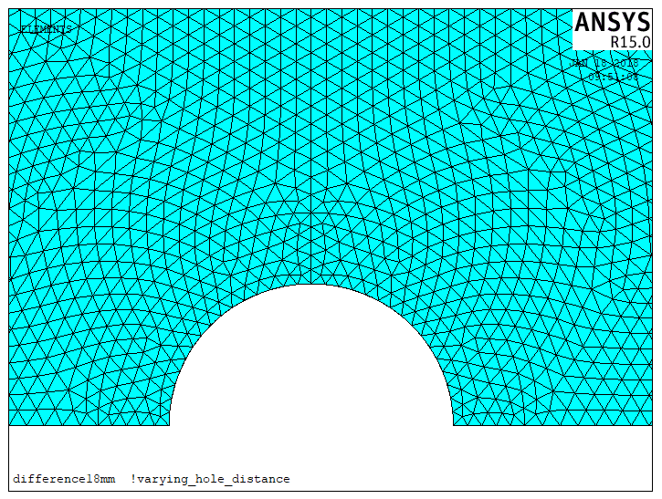
Even Finer Mesh Region
!coarse mesh
esize,0.25
!fine mesh
esize,0.2
!Cost, just uniaxial simulation
! ~12h proccessing
! 166 GB files
Notes:
C:\Manasses\varying_hole_distance_with_refined_mesh_region_2

Slide 25
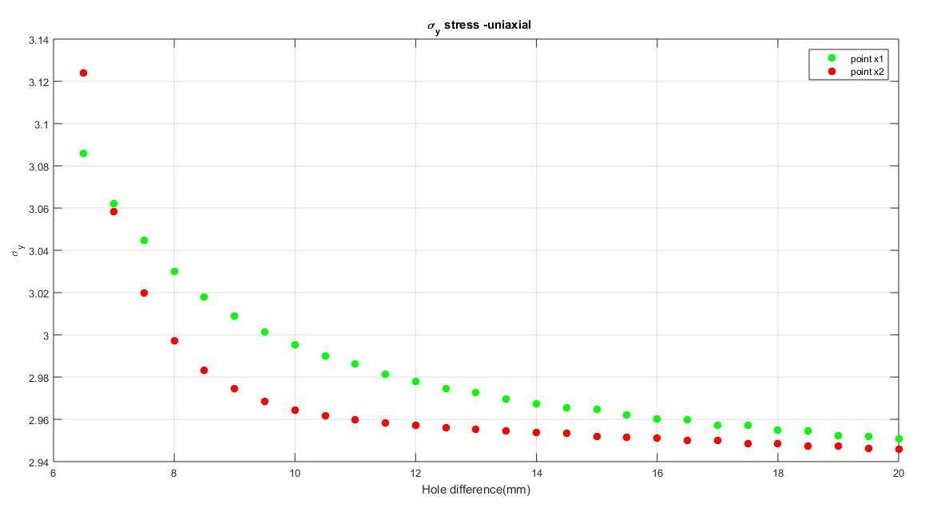
Results
Asked this mesh with 0.5 thickness ring
!coarse mesh
esize,0.5
!fine mesh
esize,0.2
!coarse mesh
esize,0.25
!fine mesh
esize,0.2
!mesh
esize,0.5
Uniaxial, Transverse load
!coarse mesh
esize,0.5
!fine mesh
esize,0.2
!mesh
esize,0.5
(b)Biaxial load

Slide 26
Uniaxial, Transverse load
!mesh
esize,0.5

Slide 27
Uniaxial, Transverse load
!coarse mesh
esize,0.5
!fine mesh
esize,0.2

Slide 28
Uniaxial, Transverse load
!coarse mesh
esize,0.25
!fine mesh
esize,0.2

Slide 29
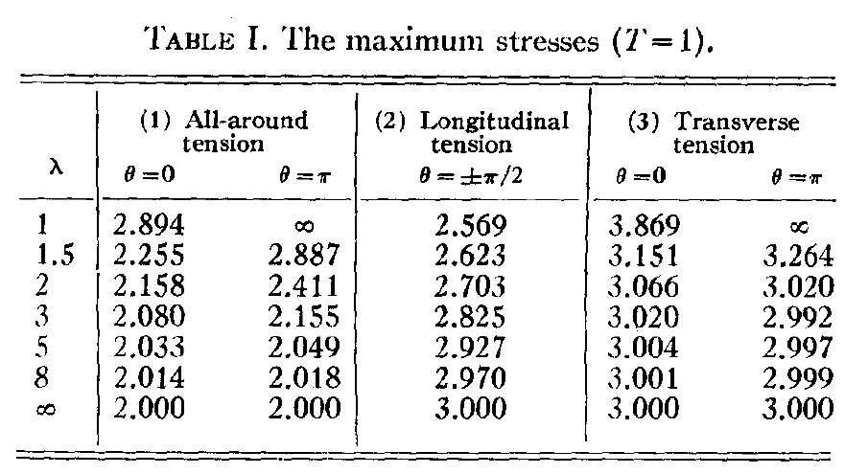
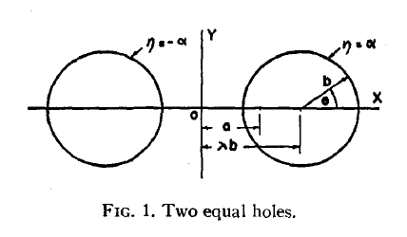
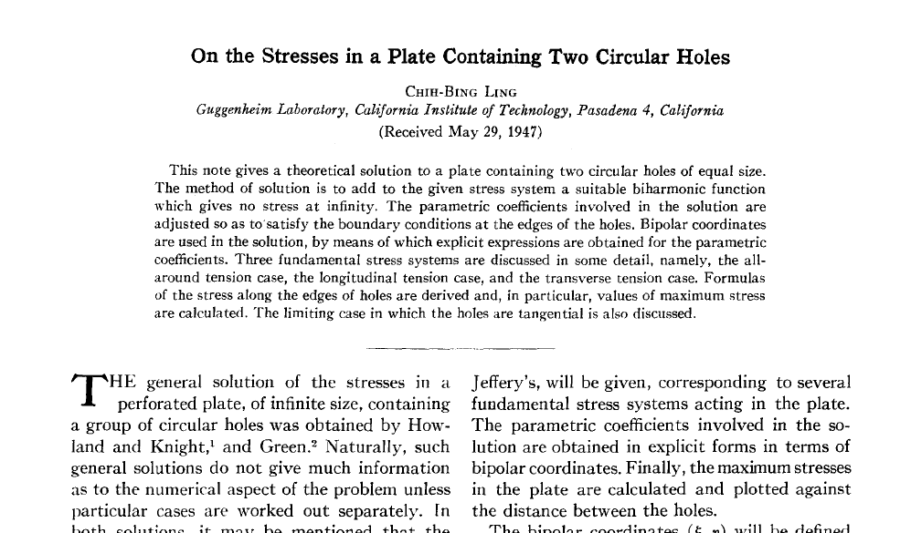
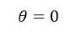
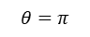
Theoretical Result
X1
X2
X2
X1
$$θ=π$$
$$θ=0$$
Notes:
C:\Manasses\articles

Slide 30
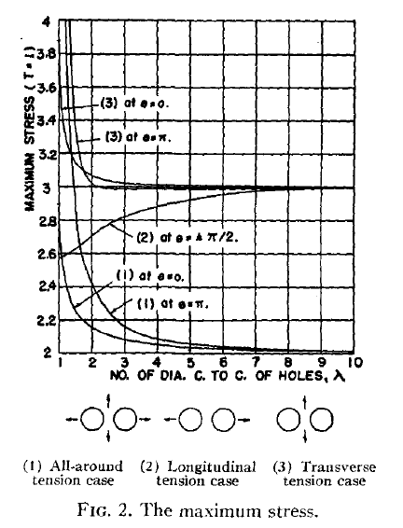
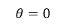
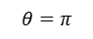
Theoretical Result
X1
X2
X2
X1
$$θ=π$$
$$θ=0$$
Notes:
C:\Manasses\articles

Slide 31

Theoretical Result
X1
X2
X1
X2
X2
X1
$$7 mm$$
$$θ=π$$
$$θ=0$$
$$λ≃1.75 → b=2 mm → diff=2∗λ∗b=7 mm$$
Notes:
C:\Manasses\articles

Slide 32
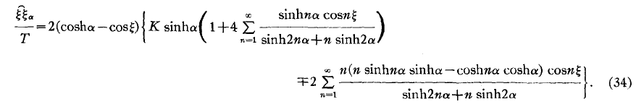
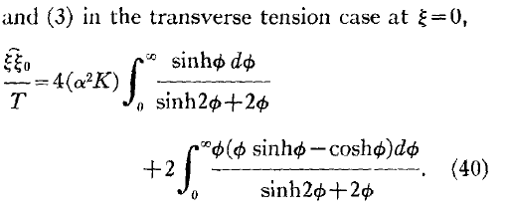
How to explain the physical phenomena ?
Notes:
C:\Manasses\articles

Slide 33
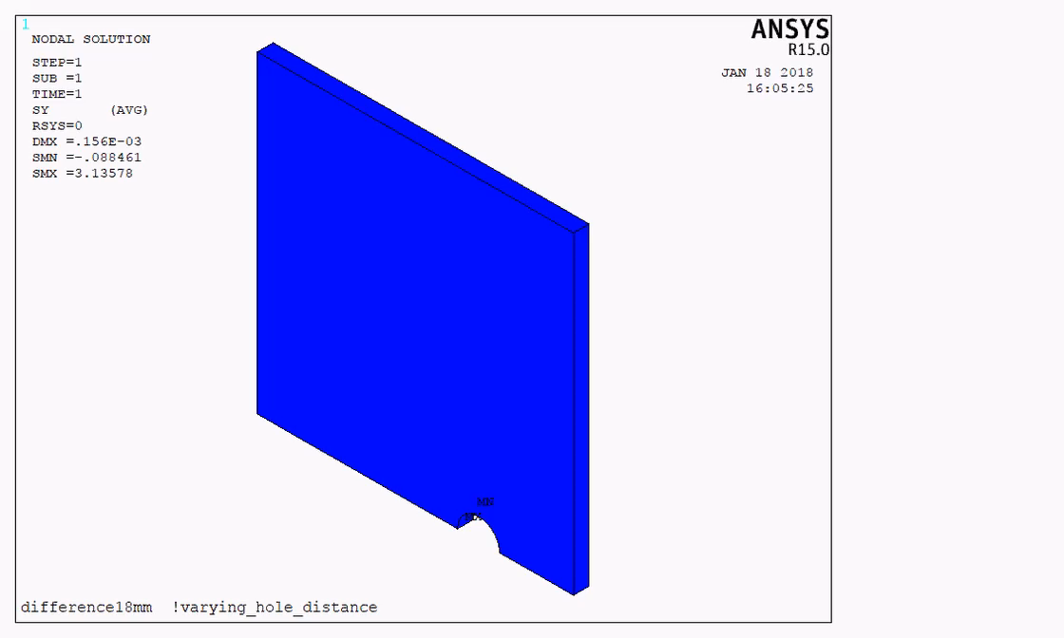
Uniaxial, Transverse load
Notes:
C:\Manasses\problem_description_presentation

Slide 34



varying_hole_distance_with_refined_mesh_region_and_different_ring_thickness
radius_int1=2.0
radius_ext1=2.5
ring_thickness = 0.5
Notes:
C:\Manasses\varying_hole_distance_with_refined_mesh_region_and_different_ring_thickness

Slide 35

Results for uniaxial (only)
varying_hole_distance_with_refined_mesh_region_and_different_ring_thickness
Notes:
C:\Manasses\varying_hole_distance_with_refined_mesh_region_and_different_ring_thickness\uniaxial

Slide 36



Center Hole
plate_1.5_depth_1.5
plate_1.5_depth_1
plate_14_depth_1
plate_1.5_depth_1.5
plate_1.5_depth_1
plate_14_depth_1
Uniaxial
Biaxial
Notes:
C:\Manasses\center_hole

Slide 37

Center Hole
center_hole_uniaxial-black_and_biaxial-blue_three_geometries
Notes:
C:\Manasses\center_hole

Slide 38


A 1.5 mm plate and two Circular Holes with 1 mm depth
60 mm
radius = 2 mm
60 mm
diff
plate_thickness = 1.5 mm
depth = 1.0 mm
“cylindrical hole”
Varying the hole distance
Notes:
C:\Manasses\varying_hole_distance_plate_1.5_depth_1_refined_mesh_region_ring

Slide 39


A 1.5 mm plate and two Circular Holes with 1 mm depth
Uniaxial, Transverse load
(b)Biaxial load
Notes:
C:\Manasses\varying_hole_distance_plate_1.5_depth_1_refined_mesh_region_ring

Slide 40


A 1.5 mm plate and two Circular Holes with 1 mm depth
Uniaxial, Transverse load
(b)Biaxial load
Notes:
C:\Manasses\varying_hole_distance_plate_1.5_depth_1_refined_mesh_region_ring

Slide 41


A 14 mm plate and two Circular Holes with 1 mm depth
60 mm
radius = 2 mm
60 mm
diff
plate_thickness = 14 mm
depth = 1.0 mm
“cylindrical hole”
Varying the hole distance
Notes:
C:\Manasses\varying_hole_distance_plate_14_depth_1_refined_mesh_region_ring

Slide 42



varying_hole_distance_plate_14_depth_1_refined_mesh_region_ring
size_refined= 0.2
esize,size_refined
size_coarse2= 0.5
esize,size_coarse2
size_coarse1=3.0
esize,size_coarse1
radius_int1=2.0
radius_ext1=2.5
ring_thickness = 0.5
Notes:
C:\Manasses\varying_hole_distance_plate_14_depth_1_refined_mesh_region_ring

Slide 43


A 14 mm plate and two Circular Holes with 1 mm depth
Uniaxial, Transverse load
(b)Biaxial load
Notes:
C:\Manasses\varying_hole_distance_plate_14_depth_1_refined_mesh_region_ring

Slide 44


A 14 mm plate and two Circular Holes with 1 mm depth
Uniaxial, Transverse load
(b)Biaxial load
Notes:
C:\Manasses\varying_hole_distance_plate_14_depth_1_refined_mesh_region_ring

Slide 45
Identified Problem
* The coarse generation is coming before fine (ring) mesh generation;
* The node sequence change is not generic in one selection command (inside a loop):
plate_1.5_depth_1.5
plate_1.5_depth_1
plate_14_depth_1
they need code repairs
Finished simulation
...
! Section A3(y2/2)
!changing nodes sequence
asel,s,loc,y,y2/2
nsla,s,1
asel,s,loc,x,x2/4
nsla,u,1
asel,s,loc,x,x2/2
nsla,u,1
...
The problem was identified
in the plate_14_depth_1 code.
It was repaired.
xcenter1

Slide 46
Files -> folders
plate_1.5_depth_1.5
plate_1.5_depth_1
plate_14_depth_1
plate_1.5_depth_1.5
varying_hole_distance_with_refined_mesh_region_and_different_ring_thickness
C:\Manasses\varying_hole_distance_with_refined_mesh_region_and_different_ring_thickness\uniaxial
?
plate_1.5_depth_1
varying_hole_distance_plate_1.5_depth_1_refined_mesh_region_ring
C:\Manasses\varying_hole_distance_plate_1.5_depth_1_refined_mesh_region_ring\uniaxial
C:\Manasses\varying_hole_distance_plate_1.5_depth_1_refined_mesh_region_ring\biaxial
plate_14_depth_1
varying_hole_distance_plate_14_depth_1_refined_mesh_region_ring
C:\Manasses\varying_hole_distance_plate_14_depth_1_refined_mesh_region_ring\uniaxial
C:\Manasses\varying_hole_distance_plate_14_depth_1_refined_mesh_region_ring\biaxial
Notes:
C:\Manasses

Slide 47
three_geometries_comparison_same_scale
plate_1.5_depth_1.5
plate_1.5_depth_1
plate_14_depth_1
Notes:
C:\Manasses\problem_description_presentation\three_geometries_comparison_same_scale

Slide 48

plate_1.5_depth_1.5
Uniaxial, Transverse load
(b)Biaxial load
Notes:
C:\Manasses\varying_hole_distance_with_refined_mesh_region_and_different_ring_thickness

Slide 49


plate_1.5_depth_1
Uniaxial, Transverse load
(b)Biaxial load
Notes:
C:\Manasses\varying_hole_distance_plate_1.5_depth_1_refined_mesh_region_ring

Slide 50


plate_14_depth_1
Uniaxial, Transverse load
(b)Biaxial load
Notes:
C:\Manasses\varying_hole_distance_plate_14_depth_1_refined_mesh_region_ring

Slide 51

Repairing the Code Problem
plate_1.5_depth_1.5 -> changing name folder
varying_hole_distance_with_refined_mesh_region_and_different_ring_thickness
varying_hole_distance_plate_1.5_depth_1.5_refined_mesh_region_ring
C:\Manasses\varying_hole_distance_plate_1.5_depth_1.5_refined_mesh_region_ring\uniaxial
C:\Manasses\varying_hole_distance_with_refined_mesh_region_and_different_ring_thickness\uniaxial
?
Notes:
C:\Manasses\varying_hole_distance_plate_1.5_depth_1.5_refined_mesh_region_ring

Slide 52



plate_1.5_depth_1.5
Comparison with the previous geometry code
Notes:
C:\Manasses\varying_hole_distance_with_refined_mesh_region_and_different_ring_thickness, C:\Manasses\varying_hole_distance_plate_1.5_depth_1.5_refined_mesh_region_ring

Slide 53


plate_1.5_depth_1.5
Comparison with the previous geometry code
Notes:
C:\Manasses\varying_hole_distance_plate_1.5_depth_1.5_refined_mesh_region_ring\plots

Slide 54

plate_1.5_depth_1.5
Notes:
C:\Manasses\varying_hole_distance_plate_1.5_depth_1.5_refined_mesh_region_ring\plots

Slide 55



plate_1.5_depth_1
Notes:
C:\Manasses\varying_hole_distance_plate_1.5_depth_1_refined_mesh_region_ring

Slide 56


plate_1.5_depth_1
Comparison with the previous geometry code
Notes:
C:\Manasses\varying_hole_distance_plate_1.5_depth_1_refined_mesh_region_ring

Slide 57

plate_1.5_depth_1
Comparison with the previous geometry code
Notes:
C:\Manasses\varying_hole_distance_plate_1.5_depth_1_refined_mesh_region_ring

Slide 58



Extending Range
inicial = 25 !mm
final = 54.5 !mm
incr = 5 !mm
*do,diff,inicial,final,incr
...
...
*enddo
Notes:
C:\Manasses\varying_hole_distance_plate_1.5_depth_1.5_refined_mesh_region_ring
C:\Manasses\varying_hole_distance_plate_14_depth_1_refined_mesh_region_ring

Slide 59






plate_1.5_depth_1.5_through_hole
Uniaxial, Transverse load
(b)Biaxial load
Notes:
C:\Manasses\varying_hole_distance_plate_1.5_depth_1.5_refined_mesh_region_ring\plots

Slide 60
plate_1.5_depth_1.5_through_hole
Notes:
C:\Manasses\varying_hole_distance_plate_1.5_depth_1.5_refined_mesh_region_ring\plots

Slide 61
plate_1.5_depth_1.5_through_hole
Notes:
C:\Manasses\varying_hole_distance_plate_1.5_depth_1.5_refined_mesh_region_ring\plots

Slide 62
plate_1.5_depth_1.5_through_hole
Notes:
C:\Manasses\varying_hole_distance_plate_1.5_depth_1.5_refined_mesh_region_ring\plots

Slide 63
plate_1.5_depth_1.5_through_hole
Notes:
C:\Manasses\varying_hole_distance_plate_1.5_depth_1.5_refined_mesh_region_ring\plots

Slide 64






plate_14_depth_1
Uniaxial, Transverse load
(b)Biaxial load
Notes:
C:\Manasses\varying_hole_distance_plate_14_depth_1_refined_mesh_region_ring

Slide 65
plate_14_depth_1
Notes:
C:\Manasses\varying_hole_distance_plate_14_depth_1_refined_mesh_region_ring\plots

Slide 66
plate_14_depth_1
Notes:
C:\Manasses\varying_hole_distance_plate_14_depth_1_refined_mesh_region_ring\plots

Slide 67
plate_14_depth_1
Notes:
C:\Manasses\varying_hole_distance_plate_14_depth_1_refined_mesh_region_ring\plots

Slide 68
plate_14_depth_1
Notes:
C:\Manasses\varying_hole_distance_plate_14_depth_1_refined_mesh_region_ring\plots

Slide 69






plate_1.5_depth_1
Uniaxial, Transverse load
(b)Biaxial load

Slide 70
Prepare slides -> problem description

Slide 71

all_uniaxial_biaxial_3_geometries
uniaxial
Notes:
C:\Manasses\all_uniaxial_biaxial_3_geometries

Slide 72

all_uniaxial_biaxial_3_geometries
uniaxial
Notes:
C:\Manasses\all_uniaxial_biaxial_3_geometries

Slide 73

all_uniaxial_biaxial_3_geometries
biaxial
Notes:
C:\Manasses\all_uniaxial_biaxial_3_geometries

Slide 74

all_uniaxial_biaxial_3_geometries
biaxial
Notes:
C:\Manasses\all_uniaxial_biaxial_3_geometries

Slide 75

https://convertio.co/pt/avi-converter/
Notes:
file:///C:/Users/LMP-LabMetro/Desktop/difference50mm.gif

Slide 76



varying_hole_distance_bending
! BENDING
! apply displacements conditions at the nodes of the line:
! x=0, z=0
allsel
lsel,s,loc,y,y2
lsel,r,loc,z,z1
nsll,s
d,all,uy,0.0145
allsel
lsel,s,loc,x,x1
lsel,r,loc,z,z1
nsll,s
d,all,ux,-0.0145
allsel
lsel,s,loc,y,y2
lsel,r,loc,z,-z2
nsll,s
d,all,uy,-0.0145
allsel
lsel,s,loc,x,x1
lsel,r,loc,z,-z2
nsll,s
d,all,ux,0.0145
!The same CODE for Uniaxial and Biaxial cases, just comment or uncomment some commands
!lines: 17/18 , 55/56 , 315/321 , 327/333
Notes:
C:\Manasses\varying_hole_distance_bending\varying_hole_distance_bending.txt

Slide 77


varying_hole_distance_bending
! UNIAXIAL BENDING
! apply displacements conditions at the nodes of the line:
! x=0, z=0
allsel
lsel,s,loc,y,y2
lsel,r,loc,z,z1
nsll,s
d,all,uy,0.0145
!
!
!
!
!
allsel
lsel,s,loc,y,y2
lsel,r,loc,z,-z2
nsll,s
d,all,uy,-0.0145
!
!
!
!
!
! BIAXIAL BENDING
! apply displacements conditions at the nodes of the line:
! x=0, z=0
allsel
lsel,s,loc,y,y2
lsel,r,loc,z,z1
nsll,s
d,all,uy,0.0145
allsel
lsel,s,loc,x,x1
lsel,r,loc,z,z1
nsll,s
d,all,ux,-0.0145
allsel
lsel,s,loc,y,y2
lsel,r,loc,z,-z2
nsll,s
d,all,uy,-0.0145
allsel
lsel,s,loc,x,x1
lsel,r,loc,z,-z2
nsll,s
d,all,ux,0.0145
Uniaxial (Transverse) Bending
Biaxial Bending
Notes:
C:\Manasses\varying_hole_distance_bending\varying_hole_distance_bending.txt

Slide 78

varying_hole_distance_bending
Uniaxial (Transverse) Bending
Notes:
C:\Manasses\varying_hole_distance_bending\varying_hole_distance_bending.txt

Slide 79

varying_hole_distance_bending
Biaxial Bending
Notes:
C:\Manasses\varying_hole_distance_bending\varying_hole_distance_bending.txt

Slide 80

varying_hole_distance_bending_80x124mm
Uniaxial (Transverse) Bending
x1 = 0
x2 = 80
y1 = 0
y2 = 124
z1 = 0
z2 = 1.5
inicial = 10
final = 72
incr = 2
Notes:
C:\Manasses\varying_hole_distance_bending_80x124mm\varying_hole_distance_bending_80x124mm.txt

Slide 81

tarefa_furo_diferente_angulos
inicial = 130
final = 180
incr = 10
*do,angle,inicial,final,incr
.
.
.
*enddo
Notes:
C:\Manasses\tarefa_furo_diferente_ângulos\strain_gauge_deformation.m

Slide 82





Result Deformation -> “tarefa_furo_diferente_angulos”
F_angle = scatteredInterpolant(xloc,zloc,ux,'linear','none');
$$ε=\sum_{i=1}^{n}{\frac{U_{i2}−U_{i1}}{\left.n(r_{2}−r_{1}\right)}}$$
matrix_u0 =[n(:,1),xloc(:,1),zloc(:,1),ux(:,1)];
%matrix with ux data, strain gauge with tetha = 0° direction
%parameters:
%take a look at the PDF NORMA
r1=3.54; %values according to the NORMA [?], distane from the hole to the initial position of the strain gauge (x axis)
r2=6.72; %values according to the NORMA [?], distane from the hole to the final position of the strain gauge (x axis)
D=(r1+r2);
GL=3.18; %strain gauge length, %values according to the NORMA [?]
GW=3.18; %strain gauge width, %values according to the NORMA [?]
ngrids=21; %number of grids -> strain gauge
strain_gauge_deformation.m
Notes:
C:\Manasses\tarefa_furo_diferente_ângulos
NORMA -> PDF: 1.ASTM E837 13A C:\Manasses\result_deformation

Slide 83
center_hole uniaxial plate_1.5_depth_1.5 “through hole”
tensile_stress_concentration_polar_equations.m
uniaxial_biaxial_stress_profile_center_hole.m
t=1 % uniaxial only
m=1 % through hole
Notes:
C:\Manasses\center_hole\uniaxial_biaxial_stress_profile_center_hole.m

Slide 84

center_hole uniaxial plate_1.5_depth_1.5 “through hole”
center_hole_uniaxial_through_hole_and_kirsch_equations_sigma_theta
Notes:
C:\Manasses\center_hole\uniaxial\plate_1.5_depth_1.5

Slide 85

center_hole uniaxial plate_1.5_depth_1.5 “through hole”
center_hole_uniaxial_through_hole_and_kirsch_equations_sigma_theta_diff_K_sim
Notes:
C:\Manasses\center_hole\uniaxial\plate_1.5_depth_1.5

Slide 86
center_hole with “through hole”
plate_1.5_depth_1.5
1º case
radius = 2 mm
plate_1.5_depth_1.5
plate_0.5_depth_0.5
radius = 1 mm
radius = 2 mm
2º case
3º case
Notes:
C:\Manasses\center_hole\uniaxial_biaxial_stress_profile_center_hole.m

Slide 87

2ºcase: plate_1.5_depth_1.5 radius=1mm
Notes:
C:\Manasses\center_hole\uniaxial_r_eq_1\plate_1.5_depth_1.5

Slide 88

2ºcase: plate_1.5_depth_1.5 radius=1mm
center_hole_uniaxial_through_hole_and_kirsch_equations_sigma_theta_diff_K_sim
Notes:
C:\Manasses\center_hole\uniaxial_r_eq_1\plate_1.5_depth_1.5

Slide 89

3ºcase: plate_0.5_depth_0.5 radius=2mm
Notes:
C:\Manasses\center_hole\uniaxial\plate_0.5_depth_0.5

Slide 90

3ºcase: plate_0.5_depth_0.5 radius=2mm
Notes:
C:\Manasses\center_hole\uniaxial\plate_0.5_depth_0.5

Slide 91
elements_images
plate_1.5_depth_1.5
plate_1.5_depth_1
plate_14_depth_1
Uniaxial
! the following code takes images from elements inside the geometry (3 geometries)
! Geometries and simulations:
! -> varying_hole_distance_plate_1.5_depth_1.5_refined_mesh_region_ring
! -> varying_hole_distance_plate_1.5_depth_1_refined_mesh_region_ring
! -> varying_hole_distance_plate_14_depth_1_refined_mesh_region_ring
allsel
diff = 30
x1 = 0
x2 = 60
y1 = 0
y2 = 60
z1 = 0
z2 = 1.5
xcenter1 = (x2 - diff)/2
allsel
vplot
/VIEW,1,0,-1
/rep
nsel,s,loc,x,xcenter1-10,xcenter1+10
nplot
esln
/post1
plnsol,s,y
!plesol,sy
/contour,1,,-0.081771,,3.12603
/rep
Notes:
C:\Manasses\elements_images

Slide 92

elements_images
plate_1.5_depth_1.5
Uniaxial
Notes:
C:\Manasses\elements_images

Slide 93

elements_images
plate_1.5_depth_1
Uniaxial
Notes:
C:\Manasses\elements_images

Slide 94

elements_images
plate_14_depth_1
Uniaxial
Fazer para Biaxial
06/03/2018
Notes:
C:\Manasses\elements_images

Slide 95
elements_images
plate_1.5_depth_1.5
plate_1.5_depth_1
plate_14_depth_1
Biaxial
! the following code takes images from elements inside the geometry (3 geometries)
! Geometries and simulations:
! -> varying_hole_distance_plate_1.5_depth_1.5_refined_mesh_region_ring
! -> varying_hole_distance_plate_1.5_depth_1_refined_mesh_region_ring
! -> varying_hole_distance_plate_14_depth_1_refined_mesh_region_ring
allsel
diff = 30
x1 = 0
x2 = 60
y1 = 0
y2 = 60
z1 = 0
z2 = 1.5
xcenter1 = (x2 - diff)/2
allsel
vplot
/VIEW,1,0,-1
/rep
nsel,s,loc,x,xcenter1-10,xcenter1+10
nplot
esln
/post1
plnsol,s,y
!plesol,sy
/contour,1,,-0.081771,,3.12603
/rep
Notes:
C:\Manasses\elements_images

Slide 96

elements_images
plate_1.5_depth_1.5
Biaxial
Notes:
C:\Manasses\elements_images

Slide 97

elements_images
plate_1.5_depth_1
Biaxial
Notes:
C:\Manasses\elements_images

Slide 98

elements_images
plate_14_depth_1
Biaxial
Notes:
C:\Manasses\elements_images

Slide 99
Sigma_min
 | Uniaxial
 | T_p/H_d=1 | T_p/H_d=1.5 | T_p/H_d=14
Point A (x1) | 2.942446768300000 | 2.722951114200000 | 1.925316333800000
Point B (x2) | 2.935607373700000 | 2.721057593800000 | 1.925137460200000
Point A (x1)
Point B (x2)
Biaxial
T_p/H_d=1 | T_p/H_d=1.5 | T_p/H_d=14
2.015860319100000 | 2.404486894600000 | 1.596784085000000
2.013187766100000 | 2.404265463400000 | 1.596903532700000
Na Geometria T_p/H_d=14,
Intervalo do Sigma_min {20,40}
Notes:
C:\Manasses\all_uniaxial_biaxial_3_geometries\all_uniaxial_biaxial_3_geometries_NEW.m

Slide 100
Sigma min calculated via u_b_s_p_center_hole_withou_kirsch.m at
C:\Manasses\center_hole\u_b_s_p_center_hole_withou_kirsch.m
sig_min(cont_min)=matriz(end,9);
 | Uniaxial
 | T_p/H_d=1 | T_p/H_d=1.5 | T_p/H_d=14
Point A (x1) | 2.933690130700000 | 2.692401707200000 | 1.920085877200000
Point B (x2) | = | = | =
Point A (x1)
Point B (x2)
Biaxial
T_p/H_d=1 | T_p/H_d=1.5 | T_p/H_d=14
2.008045554200000 | 2.378486096900000 | 1.594718247700000
= | = | =
Notes:
C:\Manasses\all_uniaxial_biaxial_3_geometries\all_uniaxial_biaxial_3_geometries_NEW.m

Slide 101

Sigma min calculated via u_b_s_p_center_hole_withou_kirsch.m at
C:\Manasses\center_hole\u_b_s_p_center_hole_withou_kirsch.m
sig_min(cont_min)=matriz(end,9);
 | Uniaxial
 | T_p/H_d=1 | T_p/H_d=1.5 | T_p/H_d=14
Point A (x1) | 2.933690130700000 | 2.692401707200000 | 1.920085877200000
Point B (x2) | = | = | =
Point A (x1)
Point B (x2)
Biaxial
T_p/H_d=1 | T_p/H_d=1.5 | T_p/H_d=14
2.008045554200000 | 2.378486096900000 | 1.594718247700000
= | = | =
Notes:
C:\Manasses\all_uniaxial_biaxial_3_geometries\all_uniaxial_biaxial_3_geometries_NEW.m

Slide 102


varying_hole_distance_2D diff=20 mm
60 mm
radius = 2 mm
60 mm
diff
plate_thickness = depth = 0.0 mm
“through hole”

Slide 103


varying_hole_distance_2D diff=20 mm
(a) Uniaxial
Transverse load
(b) Biaxial load

Slide 104


varying_hole_distance_2D diff=20 mm
$$Uniaxial Transverse Load$$
$${Sigma}_{max⁡(60X60)}^{diff=\left(5∗D\right)=20}=3.088956714$$
$${Sigma}_{max⁡(150X150)}^{diff=\left(\frac{70}{4}∗D\right)=70}=3.024106741$$
$${Sigma}_{max⁡(150X150)}^{diff=\left(5∗D\right)=20}=3.037305094$$
$$Erro=\frac{\left|{Sigma}_{max⁡(60X60)}^{diff=\left(5∗D\right)=20} − {Sigma}_{max(150X150)}^{diff=\left(\frac{70}{4}∗D\right)=70}\right|}{{Sigma}_{max(150X150)}^{diff=\left(\frac{70}{4}∗D\right)=70}}$$
$$Erro=\frac{\left|3.088956714−3.024106741\right|}{3.024106741}=0.02144433995=2.14 \%$$
$$Erro=\frac{\left|{Sigma}_{max⁡(150X150)}^{diff=\left(5∗D\right)=20} −{Sigma}_{max⁡(150X150)}^{diff=\left(\frac{70}{4}∗D\right)=70}\right|}{{Sigma}_{max⁡(150X150)}^{diff=\left(\frac{70}{4}∗D\right)=70}}$$
$Erro=\frac{\left|3.037305094−3.024106741\right|}{3.024106741}=0.00436438066853275798441798453701=0.4364 \%$
$$Biaxial Load$$
$${Sigma}_{max⁡(150X150)}^{diff=\left(5∗D\right)=20}=2.085622532$$
$${Sigma}_{max⁡(150X150)}^{diff=\left(\frac{70}{4}∗D\right)=70}=2.030161023$$
$$Erro=\frac{\left|{Sigma}_{max⁡(150X150)}^{diff=\left(5∗D\right)=20} − {Sigma}_{max(150X150)}^{diff=\left(\frac{70}{4}∗D\right)=70}\right|}{{Sigma}_{max(150X150)}^{diff=\left(\frac{70}{4}∗D\right)=70}}$$
$Erro=\frac{\left|2.085622532−2.030161023\right|}{2.030161023}=0,0273187734232251586282178366893=2.7318 \%$
Notes:
3.05471
3.04588 -> arrumar ferramentas de seleção -> setol

Slide 105




center_hole_2d
(a) Uniaxial
Transverse load
(b) Biaxial load

